Slide 1


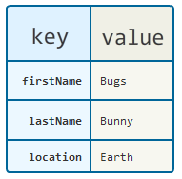

Associative Arrays and Objects
Associative Arrays, Objects
JavaScript
Basics
Svetlin Nakov
Technical Trainer
www.nakov.com
Software University
http://softuni.bg

Slide 2

Table of Contents
Associative Arrays
Object Types
JavaScript Objects Overview
JSON Objects
lodash.js

Slide 3
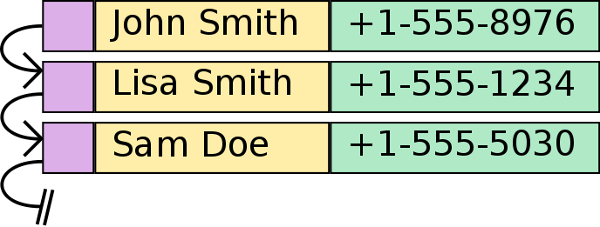
Associative Arrays

Slide 4
Associative Arrays (Maps, Dictionaries)
Associative arrays in JavaScript are called Objects holding a set of key-value pairs
Traditional array
Associative array
key
value
key
0 1 2 3 4
orange | 2.30
apple | 1.50
tomato | 3.80
value
8 | -3 | 12 | 408 | 33

Slide 5
Associative Arrays in JavaScript
Initializing an associative array (object):
Accessing elements by index:
Inserting a new element / deleting element:
Objects are not arrays → no length, no slice(), no join(), …
var prices = { 'orange' : 2.30, 'apple' : 1.50, 'tomato' : 3.80 };
console.log(prices['orange']); // 2.3
prices['cucumber'] = 1.25;
delete prices['orange'];
console.log(prices); // {apple: 1.5, tomato: 3.8, cucumber: 1.25}

Slide 6
Processing Associative Arrays
Processing associative arrays (objects) by for-in loop
Taking the keys of object / array:
var prices = {'orange' : 2.30, 'apple' : 1.50, 'tomato' : 3.80 };
for (key in prices) {
console.log(key + ' -> ' + prices[key]);
}
var prices = { 'orange' : 2.30, 'apple' : 1.50, 'tomato' : 3.80 };
console.log(Object.keys(prices)); // ["orange", "apple", "tomato"]
var nums = [10, 20, 30];
console.log(Object.keys(nums)); // ["0", "1", "2"]

Slide 7

Object Types and Objects
Modeling Real-world Entities with Objects

Slide 8
What are Objects?
Software objects model real-world objects or abstract concepts
Examples:
bank, account, customer, dog, bicycle, queue
Real-world objects have state and behavior
Account's state:
holder, balance, type
Account's behavior:
withdraw, deposit, suspend

Slide 9
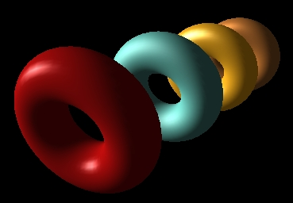
What are Objects? (2)
How do software objects implement real-world objects?
Use variables / data to implement state
Use methods / functions to implement behavior
An object is a software bundle of variables and related functions
account
owner: "Peter"
balance: 350.00
state (data)
function deposit(sum)
function withdraw(sum)
behavior (functions)

Slide 10
Objects Represent
 checks
 people
 shopping list
…
 numbers
 characters
 queues
 arrays
Things / concepts from the real world
Things / concepts from the computer world

Slide 11
What is an Object Type (Class)?
The formal definition of a object type (class):
Definition by Google
Object types act as templates from which an instance of an object is created at run time. Types define the properties of the object and the functions used to control the object's behavior.

Slide 12
Object Types
Object types provide the structure for objects
Define their prototype, act as template
Object types define:
Set of attributes
Represented by variables and properties
Hold their state
Set of actions (behavior)
Represented by methods/functions

Slide 13
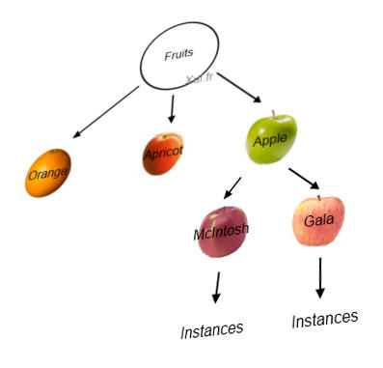
Objects
An object is a concrete instance of a particular object type
Creating an object from an object type is called instantiation
Objects have state
Set of values associated to their attributes
Example:
Type: Account
Objects: Ivan's account, Peter's account

Slide 14
Object Types and Objects – Example
Attributes
(properties and fields)
Object
ivanAccount
Object type
owner = "Ivan Kolev"
balance = 5000.0
Account
Object
peterAccount
owner
balance
owner = "Peter Kirov"
balance = 1825.50
suspend()
deposit(sum)
withdraw(sum)
Object
kirilAccount
owner = "Kiril Kirov"
balance = 25.0
Operations (functions)

Slide 15
JavaScript Objects Overview
JS
What are Objects?

Slide 16
Objects Overview
JavaScript is designed on a simple object-based paradigm
An object is a collection of properties
An object property is association between a name and a value
A value of property can be either
Property (variable / field)
Function (method)
Lots of predefined (native) objects available in JS
Math, document, window, etc…
Objects can be created by the developer

Slide 17
Objects in JS – Example
var tom = {
firstName: 'Tom',
lastName: 'Miller',
toString: function () {
return this.firstName + " " + this.lastName;
}
}
var kate = {
firstName: 'Kate',
lastName: 'Brown',
toString: function () {
return this.firstName + " " + this.lastName;
}
}

Slide 18
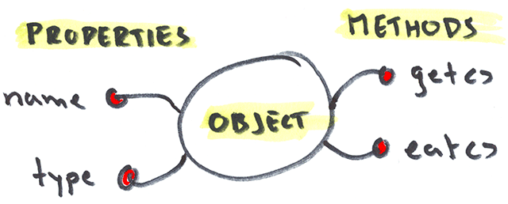
Objects and Properties
Live Demo

Slide 19
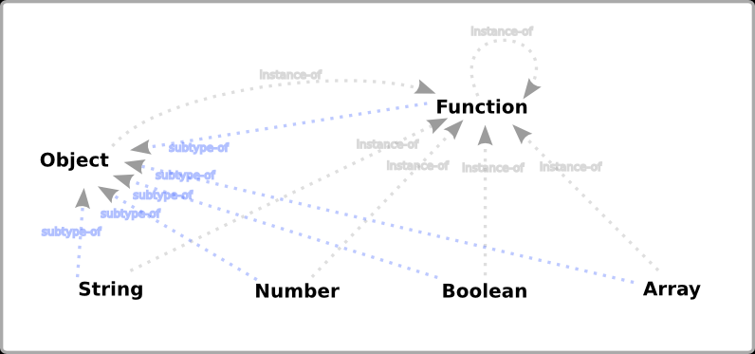
Object and Primitive Types
Types in JavaScript

Slide 20
Reference and Primitive Types
JavaScript is a typeless language
Variables don’t have type, but their values do
JavaScript has six different types:
number, string, boolean, null, undefined and object
Object is the only Object type
It is copied by reference
number, string, boolean, null, undefined are primitive types
Copied by value

Slide 21
Reference and Primitive Types (2)
The primitive types are boolean, number, string, undefined and null
All the other types are actually of type object
Including arrays, dates, custom types, etc…
All types derive from object
Their type is object
console.log(typeof new Object() === typeof new Array()); // true
console.log(typeof new Object() === typeof new Date()); // true
console.log(typeof new Array() === typeof new Date()); // true

Slide 22
Primitive Types
Primitive types are passed by value
When passed as argument
New memory is allocated
The value is copied in the new memory
The value in the new memory is passed
Primitive types are initialized with type literals
Primitive types have an object type wrapper
var number = 5;
var text = 'Hello there!';

Slide 23
Primitive Types – Example
Assign string values to two variables
Create an object using their value
Change the value of the variables
Each object has its own value
var fName = 'Pesho';
var lName = 'Ivanov';
var person = { firstName: fName, lastName: lName };
lName = 'Petrov';
console.log(person.lastName) // logged 'Ivanov'

Slide 24

Primitive and Reference Types in JS
primitive
reference
Live Demo

Slide 25
Object Type
Except primitives, all other types are objects
When passed to a function, the value is not copied, but instead a reference of it is passed
var marks = [
{ subject : 'Java', score : 6.00 },
{ subject : 'HTML5', score : 5.90 },
{ subject : 'JavaScript', score : 6.00 },
{ subject : 'PHP', score : 6.00 }];
var student = { name: 'Deyan Dachev', marks: marks };
marks[1].score = 5.50;
console.log(student.marks[1]); // logs 5.50 for HTML5 score

Slide 26
Object Cloning
Shared object – two variables holding the same object:
Cloned objects – two variables holding separate objects:
var peter = { name: 'Peter', age: 21 };
var maria = peter;
maria.name = 'Maria';
console.log(maria); // Object {name: "Maria", age: 21}
console.log(peter); // Object {name: "Maria", age: 21}
var peter = { name: 'Peter', age: 21 };
var maria = JSON.parse(JSON.stringify(peter));
maria.name = 'Maria';
console.log(maria); // Object {name: "Maria", age: 21}
console.log(peter); // Object {name: "Peter", age: 21}

Slide 27
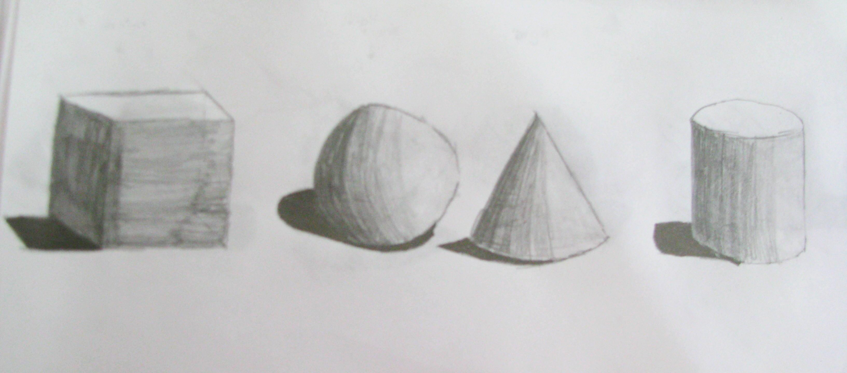
Object Types
Live Demo

Slide 28

JSON Objects
Creating Simple objects

Slide 29
JSON Objects
JSON stands for JavaScript Object Notation
A data format used in JavaScript, the "prop:value" notation
var person = {
firstName: 'Dicho',
lastName: 'Dichov',
toString: function personToString() {
return this.firstName + ' ' + this.lastName;
}
}

Slide 30
JS Object ↔ JSON String
JSON.stringify(obj)
Converts a JS object to JSON string:
JSON.parse(str)
Creates a JS object by JSON string:
var obj = { town: 'Sofia', gps: {lat: 42.70, lng: 23.32} }
var str = JSON.stringify(obj);
var str = '{"town":"Sofia","gps":{"lat":42.70,"lng":23.32}}';
var obj = JSON.parse(str);
// both lines below throw SyntaxError
JSON.parse('{foo:"bar"}');
JSON.parse("{'foo':'bar'}");

Slide 31
Building a JSON Object
JSON is great, but repeating code is not, right?
Lets make several people:
var dicho = {fname: 'Dicho', lname: 'Dichov',
toString: function() { return this.fname + ' ' + this.lname; }
}
var georgiev = { fname: 'Georgi', lname: 'Georgiev', toString: function() { return this.fname + ' ' + this.lname; }
}
var kirova = { fname: 'Maria', lname: 'Kirova', toString: function() { return this.fname + ' ' + this.lname; }
}

Slide 32
JSON Building Function
A function for building JSON objects
Just pass first and last name and get an object
Something like a constructor
function buildPerson(fname, lname) {
return {
fname: fname,
lname: lname,
toString: function () { return this.fname + ' ' + this.lname; }
}
}
var dichov = buildPerson('Dicho', 'Dichov');
var georgiev = buildPerson('Georgi', 'Georgiev');

Slide 33

JSON Objects
Live Demo

Slide 34

Lo-Dash

Slide 35
What is lodash.js?
A JavaScript utility library delivering consistency, modularity, performance & extras.
Download link https://raw.github.com/lodash/lodash/3.3.1/lodash.js
_.assign({ 'a': 1 }, { 'b': 2 }, { 'c': 3 }); // → { 'a': 1, 'b': 2, 'c': 3 } _.map([1, 2, 3], function(n) { return n * 3; }); // → [3, 6, 9]

Slide 36
What do we use Lo-Dash for?
Lo-Dash (and it’s older cousin Underscore.js) provide functional programming library
array manipulation
collections manipulation
function customization
object creation
string manipulation
and many more…

Slide 37
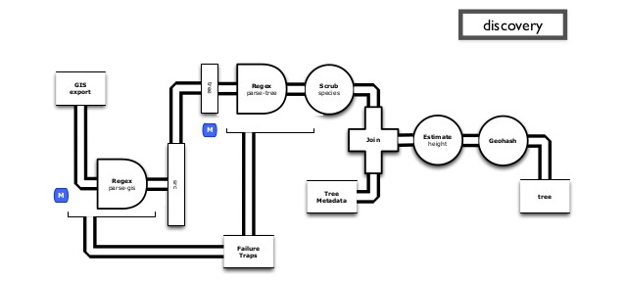

Lo-Dash
Live Demo

Slide 38

Summary
Associative Arrays
Objects in JavaScript
Reference types
Primitive types
What is JSON? JSON ← → String
Lo-Dash Library for performance

Slide 39








Associative Arrays and Objects
https://softuni.bg/courses/javascript-basics

Slide 40
License
This course (slides, examples, demos, videos, homework, etc.) is licensed under the "Creative Commons Attribution-NonCommercial-ShareAlike 4.0 International" license
Attribution: this work may contain portions from
"Fundamentals of Computer Programming with C#" book by Svetlin Nakov & Co. under CC-BY-SA license
"C# Part I" course by Telerik Academy under CC-BY-NC-SA license

Slide 41





Free Trainings @ Software University
Software University Foundation – softuni.org
Software University – High-Quality Education, Profession and Job for Software Developers
softuni.bg
Software University @ Facebook
facebook.com/SoftwareUniversity
Software University @ YouTube
youtube.com/SoftwareUniversity
Software University Forums – forum.softuni.bg

